Slide 1
Hiring Process Analytics Project

Slide 2
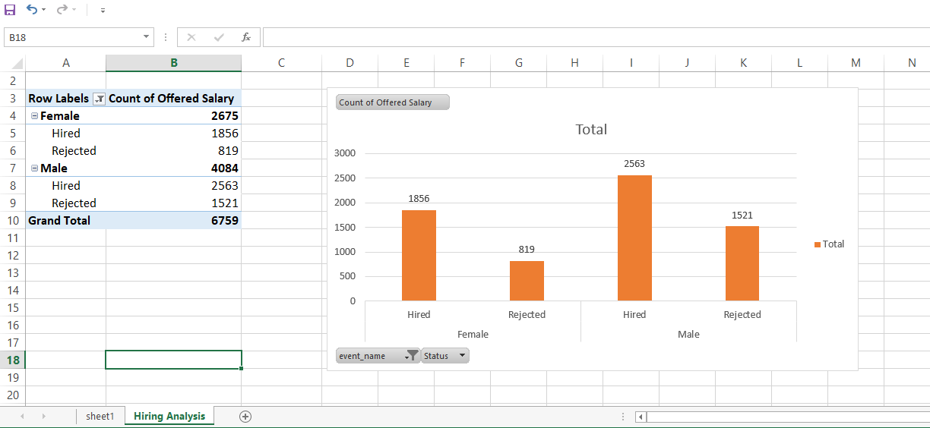
Hiring Analysis

Slide 3
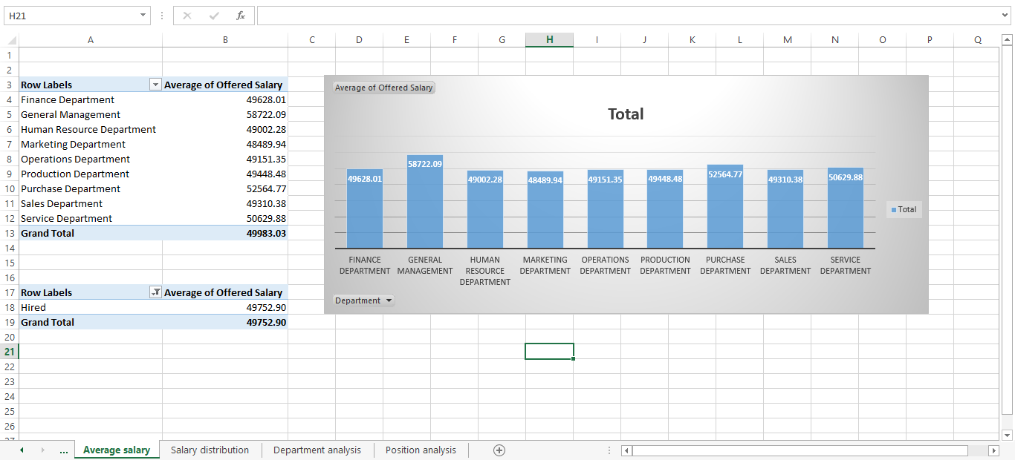
Salary Analysis

Slide 4
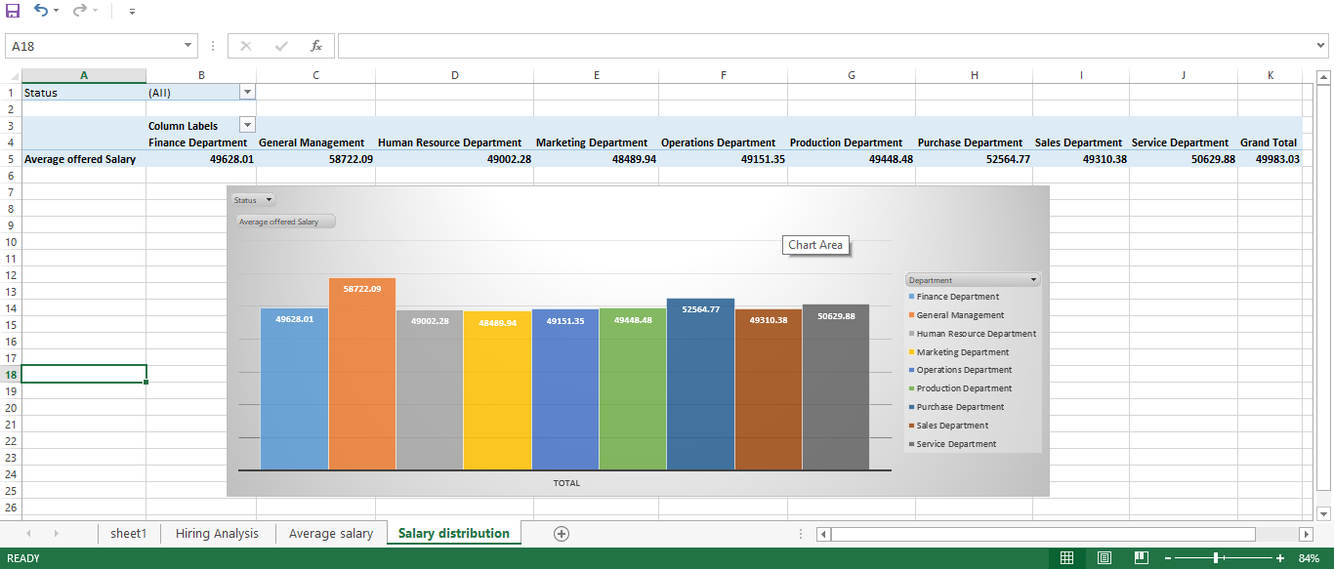
Salary Distribution

Slide 5
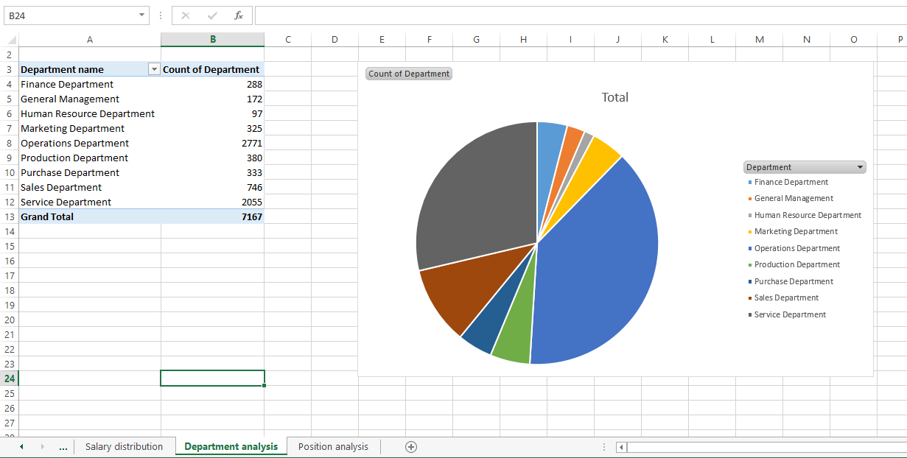
Departmental Analysis

Slide 6
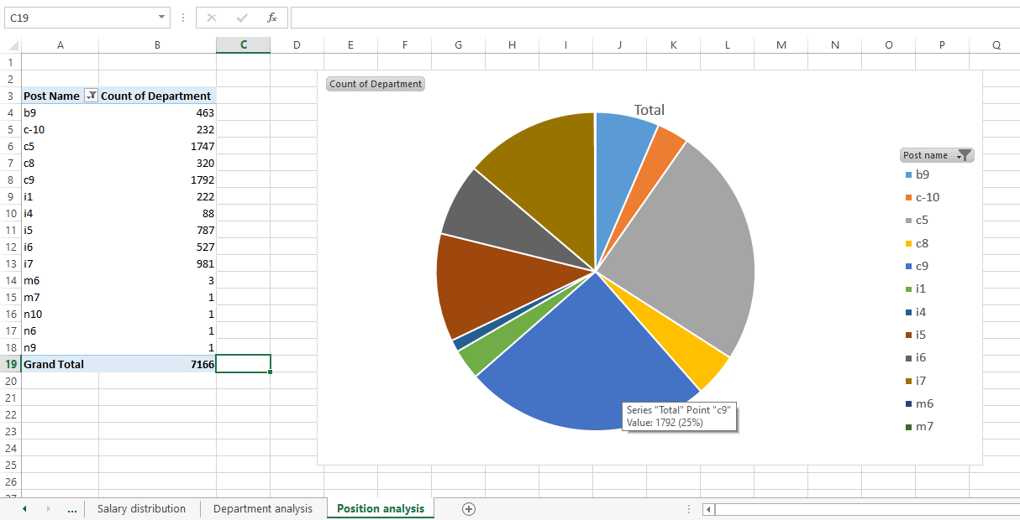
Position Tier Analysis

